Slide 1
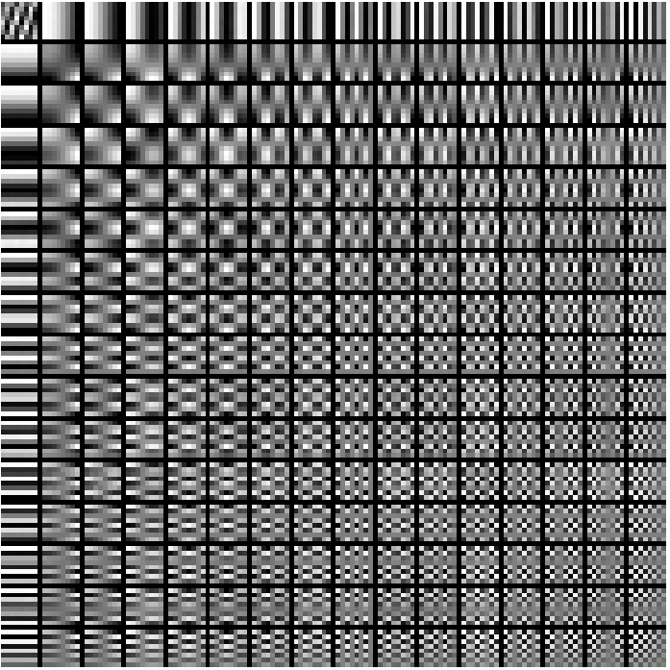
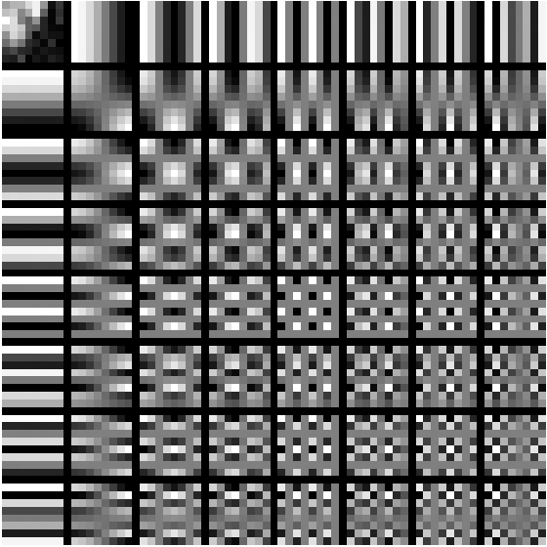
Advanced Machine Learning

Slide 2
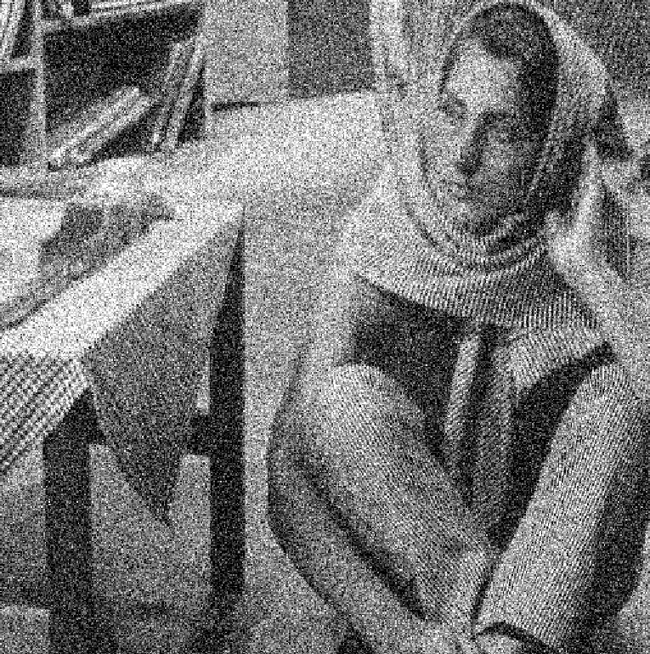

Slide 3
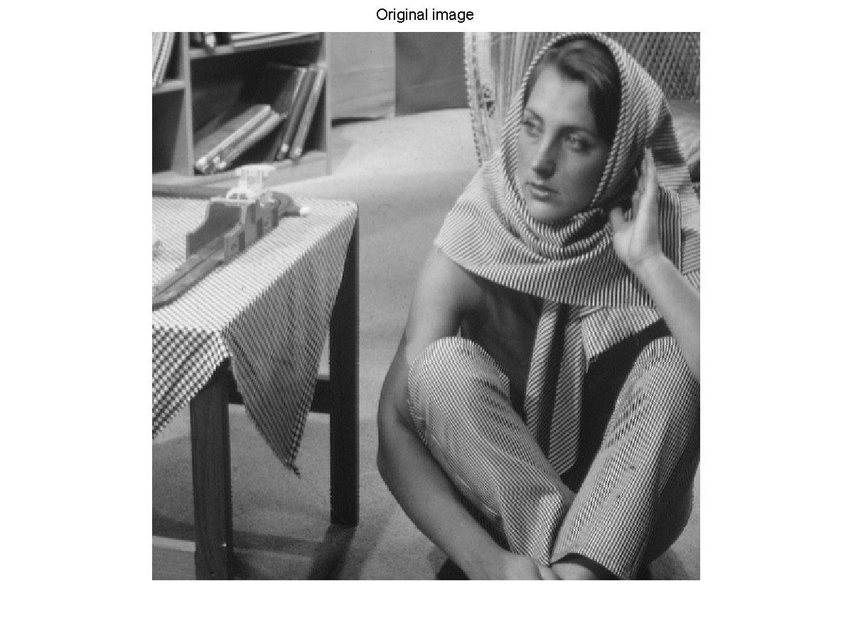

Slide 5

$$x_{1}$$
$$0$$
$$0$$
0
$$x_{5}$$
0
$$x_{7}$$
0
=
+
+

Slide 6
Sparse Coding Techniques for Dictionary Learning in Context of Image De-noising
Sarah Panda (sp3206)
Dhaivat Shah (ds3267)
Gaurav Ahuja (ga2371)

